Slide 1
KPI Report Deck (Monthly Report) Infographics
Here is where this template begins

Slide 2
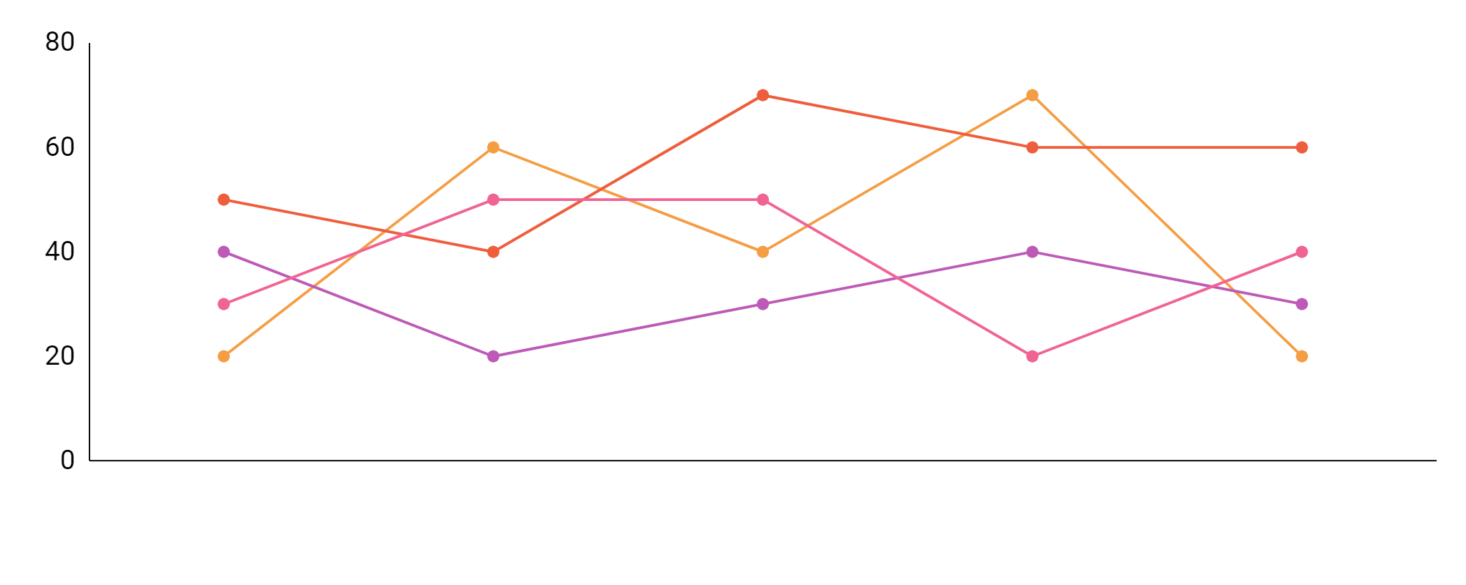
KPI Report Deck (Monthly Report) Infographics
January Contracts
February Contracts
Mercury is the closest planet to the Sun
Neptune is the farthest planet
March Contracts
April Contracts
Despite being red, Mars is a cold place
It's the biggest planet in the Solar System
Jan
Feb
Mar
Apr
May
Jun
46%
34%
22%
68%
Mercury is the closest planet to the Sun
Despite being red, Mars is a cold place
Neptune is the farthest planet from the Sun
Jupiter is the biggest planet of them all

Slide 3
KPI Report Deck (Monthly Report) Infographics
60%
10,000
8,000
4,000
10,000
40%
20%
CONTRACT STATUS
CONTRACTS BY INDUSTRY
JUNE 2020 | JULY 2020 | AUGUST 2020
Mercury is now the smallest | Mars is a very cold place | Jupiter is the biggest planet
Mercury is the closest planet to the Sun
Neptune is the farthest planet from the Sun
OLD CONTRACTS
NEW CONTRACTS
Despite being red, Mars is a cold place
It's the biggest planet in the Solar System

Slide 4
KPI Report Deck (Monthly Report) Infographics
Completed Tasks
Venus has a beautiful name and is the second planet from the Sun
40%
30%
Tasks in Progress
Mercury is the closest planet to the Sun and also is the smallest one
Not Started Tasks
Despite being red, Mars is a very cold place full of iron oxide dust
60%
50%
Pending Tasks
Jupiter is a gas giant and also the biggest planet in the Solar System

Slide 5
KPI Report Deck (Monthly Report) Infographics
21%
28%
30%
39%
34%
% JANUARY
% FEBRUARY
% MARCH
% APRIL
Mercury is the closest planet to the Sun
Venus is the second planet from the Sun
Jupiter is the biggest planet of them all
Saturn is the ringed one and a gas giant

Slide 6
KPI Report Deck (Monthly Report) Infographics
A
18%
Mercury
B
C
92%
Mars
D
83%
Saturn
% New Contracts
% Finished Contracts
Mercury is the smallest planet to the Sun
Saturn is composed of hydrogen and helium
% Old Contracts
% Unfinished Contracts
77%
Neptune
Despite being red, Mars is a very cold place
Neptune is the farthest planet from the Sun

Slide 7
KPI Report Deck (Monthly Report) Infographics
Taxes 01
Mercury is the closest planet to the Sun
Taxes 02
Despite being red, Mars is a cold place
Taxes 03
Saturn is composed of hydrogen and helium
Taxes 04
Neptune is the farthest planet from the Sun
Total Apr
Total May
Total Jun
Total Jul
55%
74%
67%
89%

Slide 8
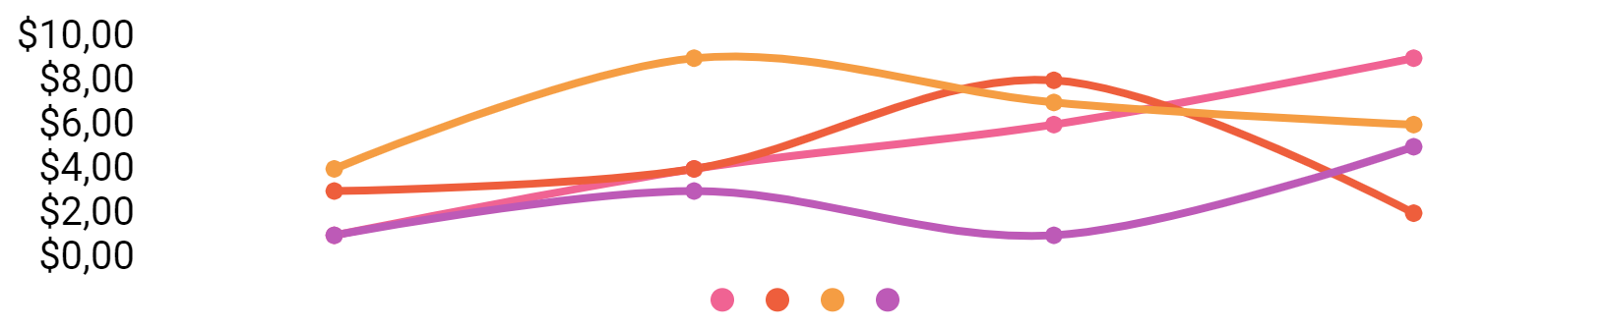
KPI Report Deck (Monthly Report) Infographics
Improvement
20%
M
Tu
W
Th
F
Sa
Su
1
2
3
4
5
6
7
Sales Increase
10%
8
9
10
11
12
13
14
January 2020
Orders Increase
50%
15
16
17
18
19
20
21
22
23
24
25
26
27
28
Benefit Increase
20%
29
30
31
Jupiter is the biggest planet
Venus has a beautiful name
Mars is actually a cold place
Earth is where we all live on
To modify this graph, click on it, follow the link, change the data and paste the new graph here

Slide 9
KPI Report Deck (Monthly Report) Infographics
25%
50%
75%
100%
Interest & Taxes
Interest & Taxes
Interest & Taxes
Interest & Taxes
+12
+24
+39
+34
JANUARY
FEBRUARY
MARCH
APRIL
Mercury is the closest planet to the Sun
Saturn is a gas giant and has several rings
Despite being red, Mars is a cold place
Venus is the second planet from the Sun

Slide 10
KPI Report Deck (Monthly Report) Infographics
January 2019 Info
Average 01-10
Mercury is the smallest planet in the entire Solar System
Average 10-20
Despite being red, Mars is actually a cold place full of iron oxide dust
90%
70%
40%
Average 20-30
Average 01-10
Average 11-20
Average 21-30
90%
70%
40%
Jupiter is a gas giant and the biggest one in the Solar System
January 2020 Info

Slide 11
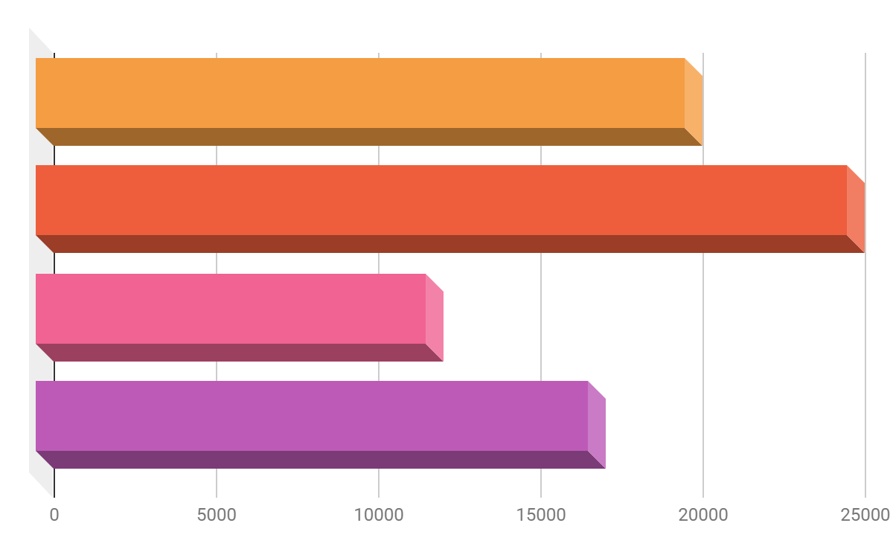
KPI Report Deck (Monthly Report) Infographics
75 %
Mercury
50 %
Jupiter
Venus
30 %
Saturn
20 %
20,000
12,000
25,000
15,000
MERCURY
SATURN
VENUS
JUPITER
It’s the smallest planet in the Solar System
It’s composed mostly of hydrogen and helium
Venus has a very poisonous atmosphere
It’s the biggest planet in the Solar System

Slide 12
KPI Report Deck (Monthly Report) Infographics
70%
35%
80%
50%
January Results
February Results
March Results
April Results
Mercury is the closest planet to the Sun and the smallest one
Despite being red, Mars is cold and full of iron oxide dust
It’s a gas giant and the biggest planet in the Solar System
Saturn is composed mostly of hydrogen and also helium

Slide 13
KPI Report Deck (Monthly Report) Infographics
July 2019 Units
August 2019 Units
September 2019 Units
October 2019 Units
November 2019 Units
December 2019 Units
 | JANUARY 2021 | FEBRUARY 2021 | MARCH 2021 | APRIL 2021
MONTH INFO | Mercury is the smallest planet | Despite being red, Mars is a cold place | It's a gas giant and is the biggest planet | Venus has a beautiful name

Slide 14
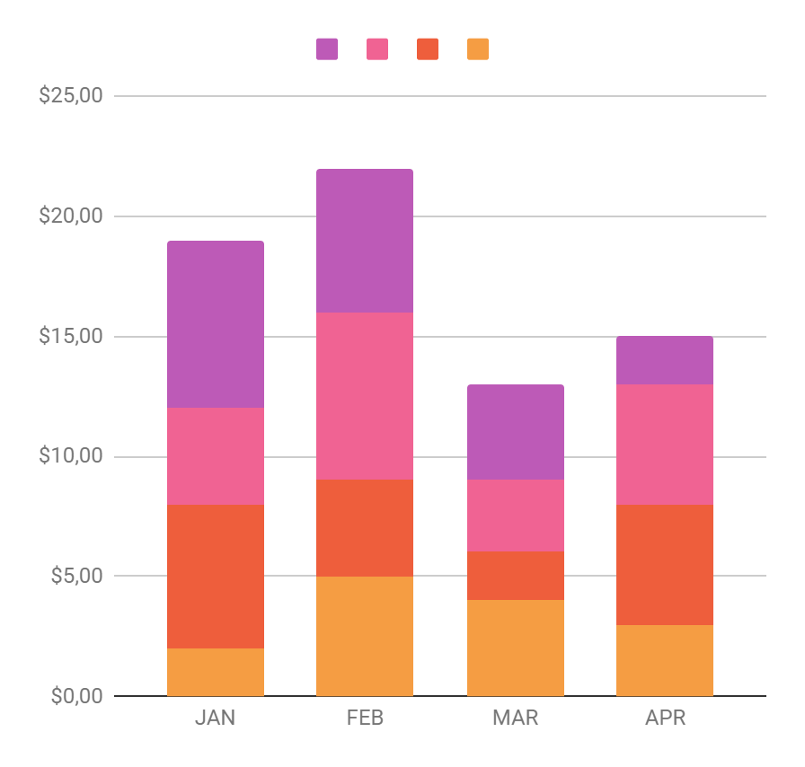
KPI Report Deck (Monthly Report) Infographics
January Interests
February Interests
Mars is actually a very cold place
Jupiter is the biggest planet
March Interests
April Interests
Mercury is a small planet
Neptune is far away from Earth
JAN
FEB
MAR
APR

Slide 15
KPI Report Deck (Monthly Report) Infographics
Jan 2020 Sales
50%
Venus has a beautiful name and is the second one from the Sun
Feb 2020 Sales
60%
Mercury is the closest planet to the Sun and the smallest one
Mar 2020 Sales
75%
Despite being red, Mars is a cold place full of iron oxide dust
Apr 2020 Sales
70%
Jupiter is a gas giant and the biggest planet of them all

Slide 16

KPI Report Deck (Monthly Report) Infographics
$265
$159
$158
Mars is actually a very cold place
Earth is where we all live on
Pluto is an icy dwarf planet
300
50%
75%
200
100
January 2020
January 2019
0
Mercury is the smallest planet
Saturn is a gas giant and has rings
Jan
Feb
Mar
Apr
May
Jun
To modify this graph, click on it, follow the link, change the data and paste the new graph here

Slide 17
KPI Report Deck (Monthly Report) Infographics
1st Revenue
2nd Revenue
3rd Revenue
85%
80%
50%
90%
70%
40%
75%
80%
60%
60%
85%
95%
Jan 2020
Feb 2020
Mar 2020
Apr 2020
Earth is the only planet with life
Venus is the second planet from Sun
Mars is a cold place full of iron oxide dust
Saturn is a gas giant and has several rings

Slide 18
KPI Report Deck (Monthly Report) Infographics
Venus
Saturn
Mars
Jupiter
Jan 2020 | Feb 2020 | March 2020 | April 2020 | May 2020

Slide 19
KPI Report Deck (Monthly Report) Infographics
Sales 1st Month
60%
Despite being red, Mars is a cold place
Sales 2nd Month
70%
Neptune is the farthest planet from the Sun
Sales 3rd Month
80%
Mercury is the closest planet to the Sun
Sales 4th Month
55K
65K
90%
It’s composed of hydrogen and also helium
75K
85K

Slide 20
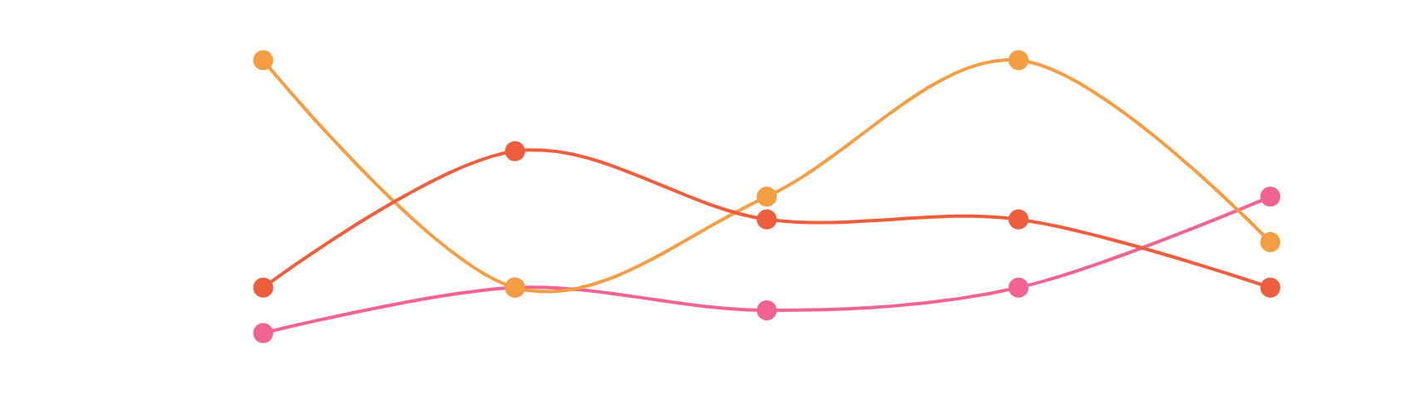
KPI Report Deck (Monthly Report) Infographics
300
Sales Item 01
200
Sales Item 02
Sales Item 03
100
To modify this graph, click on it, follow the link, change the data and paste the new graph here
0
Jan
Feb
Mar
Apr
May
125,946
157,954
365,789
Jupiter is the biggest planet
Venus has a beautiful name
Mars is actually a very cold place

Slide 21
KPI Report Deck (Monthly Report) Infographics
January 2020 Gross Profit
January 2020 Net Profit
Despite being red, Mars is actually a very cold place
Venus has a beautiful name and is the second planet
45%
90%
65%
70%
25%
40%

Slide 22
KPI Report Deck (Monthly Report) Infographics
Benefits by Month
Despite its reddish cast, Mars is actually an incredibly cold place
50%
70%
80%
Taxes by Month
Mercury is the closest planet to the Sun and the smallest one of them all
$700
$400
$800
$500
2017
Interest by Month
2018
Saturn is a planet composed mostly of hydrogen and helium
2019
2020

Slide 23
KPI Report Deck (Monthly Report) Infographics
Jupiter
75%
Mars
87%
Venus
50%
M
T
W
T
F
S
S
1
2
3
4
5
6
7
8
9
10
11
12
13
14
15
16
17
18
19
20
21
22
23
24
25
26
27
28
Saturn
Jupiter
Venus
29
30
31

Slide 24
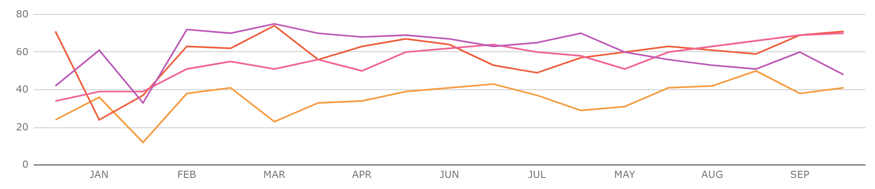
KPI Report Deck (Monthly Report) Infographics
1st Taxes
2nd Taxes
3rd Taxes
4th Taxes
1st % Interest
2nd % Interest
3rd % Interest
4th % Interest

Slide 25
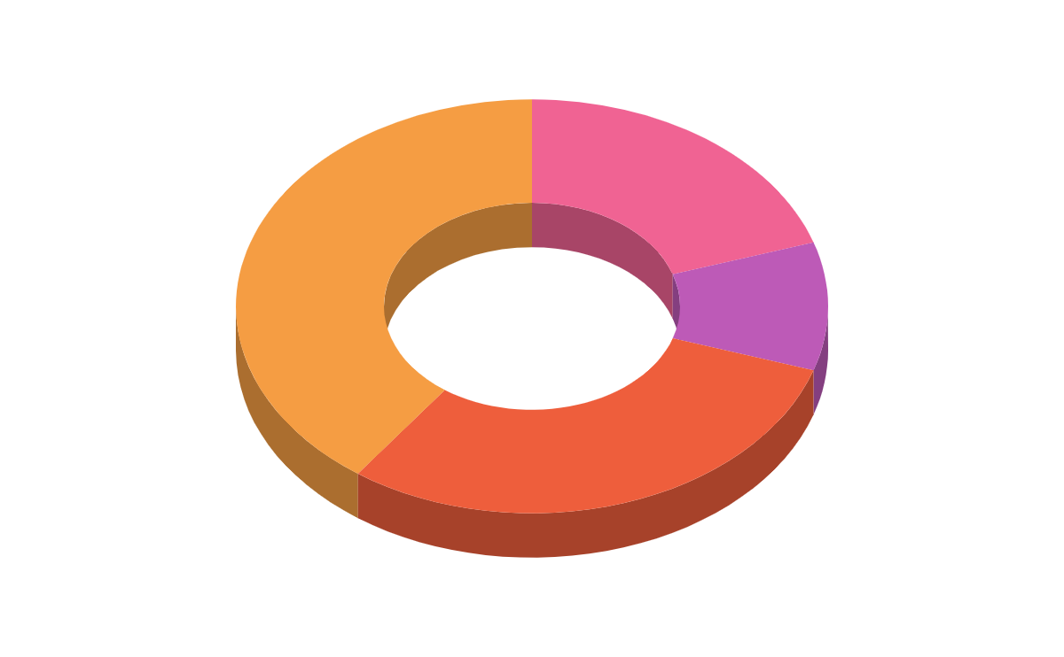
KPI Report Deck (Monthly Report) Infographics
25 %
20 %
Venus
Mars
It’s the second planet from the Sun
Despite being red, Mars is a cold place
15 %
40 %
Mercury
Neptune
It’s the smallest planet in the Solar System
It’s the farthest planet from the Sun

Slide 26
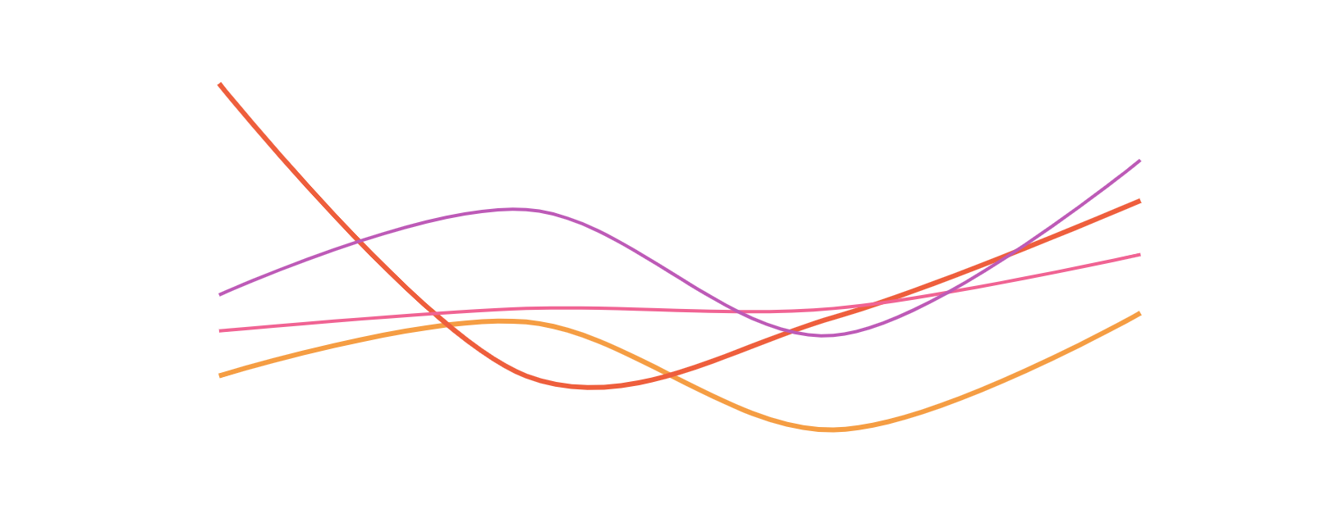
KPI Report Deck (Monthly Report) Infographics
Mars
300
Venus
Despite being red, Mars is actually a very cold place
200
Venus has a beautiful name, but it’s terribly hot
100
Jupiter
0
Neptune
Jan
Feb
Mar
Apr
May
Jupiter is the biggest planet in the Solar System
Neptune is the farthest planet from the Sun
To modify this graph, click on it, follow the link, change the data and paste the new graph here, replacing this one
25%
50%
70%
95%

Slide 27
KPI Report Deck (Monthly Report) Infographics
SEP-2019
OCT-2019
NOV-2019
DEC-2019
JAN-2020
FEB-2020
WEEK 1
WEEK 2
WEEK 3
WEEK 4
Available
Not available

Slide 28
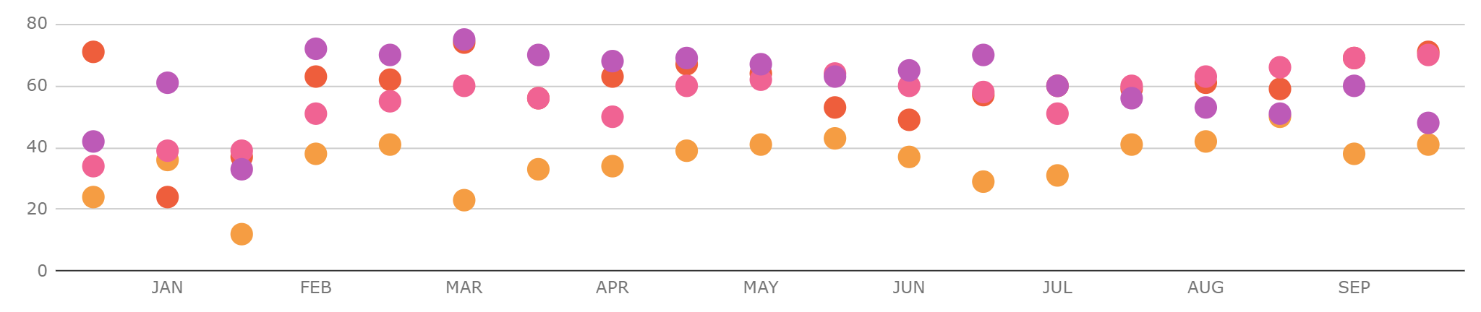
KPI Report Deck (Monthly Report) Infographics
To modify this graph, click on it, follow the link, change the data and paste the resulting graph here
Taxes A
January
65%
Taxes B
February
73%
Taxes C
March
48%
April
80%
Taxes D

Slide 29
KPI Report Deck (Monthly Report) Infographics
Monthly Report
January 2020
Taxes | Benefits | Customers | Items
2,450 | 12,850 | 6,900 | 4,300
3,900 | 11,300 | 8,560 | 5,900
5,280 | 15,910 | 9,320 | 6,100
6,490 | 17,840 | 11,200 | 8,190
37%
63%
Venus has a beautiful name
The Moon is a big satellite
Mercury
Saturn
70%
30%
Mercury is the closest planet to the Sun
Saturn is the ringed one and a gas giant
Jupiter is the biggest planet
The Sun is a giant star

Slide 30
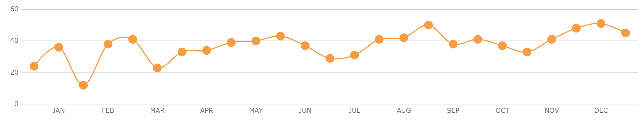
KPI Report Deck (Monthly Report) Infographics
To modify this graph, click on it, follow the link, change the data and paste the new graph here
65%
29%
58%
90%
Mars
Venus
15%
Despite being red, Mars is cold
Venus has a beautiful name
30%
Saturn
Mercury
40%
Saturn is a gas giant and has rings
Mercury is the smallest planet
15%

Slide 31
KPI Report Deck (Monthly Report) Infographics
560
2.7%
+18.5
January Average Users
January Conversion
January Average
+20%
+21%
+24%
Venus has a beautiful name
Venus has a beautiful name
Venus has a beautiful name
+46%
+32%
+37%
Mars is actually a cold place
The Moon is the Earth's satellite
Saturn is the ringed planet

Slide 32
Instructions for use (free users)
In order to use this template, you must credit Slidesgo by keeping the Thanks slide.
You are allowed to:
Modify this template.
Use it for both personal and commercial purposes.
You are not allowed to:
Sublicense, sell or rent any of Slidesgo Content (or a modified version of Slidesgo Content).
Distribute this Slidesgo Template (or a modified version of this Slidesgo Template) or include it in a database or in any other product or service that offers downloadable images, icons or presentations that may be subject to distribution or resale.
Use any of the elements that are part of this Slidesgo Template in an isolated and separated way from this Template.
Delete the “Thanks” or “Credits” slide.
Register any of the elements that are part of this template as a trademark or logo, or register it as a work in an intellectual property registry or similar.
For more information about editing slides, please read our FAQs or visit Slidesgo School:
https://slidesgo.com/faqs and https://slidesgo.com/slidesgo-school

Slide 33
Instructions for use (premium users)
In order to use this template, you must be a Premium user on Slidesgo.
You are allowed to:
Modify this template.
Use it for both personal and commercial purposes.
Hide or delete the “Thanks” slide and the mention to Slidesgo in the credits.
Share this template in an editable format with people who are not part of your team.
You are not allowed to:
Sublicense, sell or rent this Slidesgo Template (or a modified version of this Slidesgo Template).
Distribute this Slidesgo Template (or a modified version of this Slidesgo Template) or include it in a database or in any other product or service that offers downloadable images, icons or presentations that may be subject to distribution or resale.
Use any of the elements that are part of this Slidesgo Template in an isolated and separated way from this Template.
Register any of the elements that are part of this template as a trademark or logo, or register it as a work in an intellectual property registry or similar.
For more information about editing slides, please read our FAQs or visit Slidesgo School:
https://slidesgo.com/faqs and https://slidesgo.com/slidesgo-school

Slide 34
Infographics
You can add and edit some infographics to your presentation to present your data in a visual way.
Choose your favourite infographic and insert it in your presentation using Ctrl C + Ctrl V or Cmd C + Cmd V in Mac.
Select one of the parts and ungroup it by right-clicking and choosing “Ungroup”.
Change the color by clicking on the paint bucket.
Then resize the element by clicking and dragging one of the square-shaped points of its bounding box (the cursor should look like a double-headed arrow). Remember to hold Shift while dragging to keep the proportions.
Group the elements again by selecting them, right-clicking and choosing “Group”.
Repeat the steps above with the other parts and when you’re done editing, copy the end result and paste it into your presentation.
Remember to choose the “Keep source formatting” option so that it keeps the design. For more info, please visit Slidesgo School.

